Slide 1
Exchange self-sovereign cryptocurrency reserve and control over reserve
리란:201824635
조우링샤오:201924628
저우가오펑:201924621
지도교수:권동현
–computer science graduation project
2023.06.19
Notes:
크 ㄴ옹ㄹ놈ㅐ뢔

Slide 2
1.배경
2.구성원별 역할
목차
3.구현 내용
4.결론

Slide 3
배경
1.보안문제(해커가 훔친 디지털 통화)
2.거액의 손실（막대한 손실을 초래하는 고객 자산의 유용
Misappropriation of client assets resulting in huge losses 예:FTX exchange）
Notes:
ㅗㅁㄴ로해ㅑㅂ도헤ㅗㅠㅔㅈ규ㅗ

Slide 4
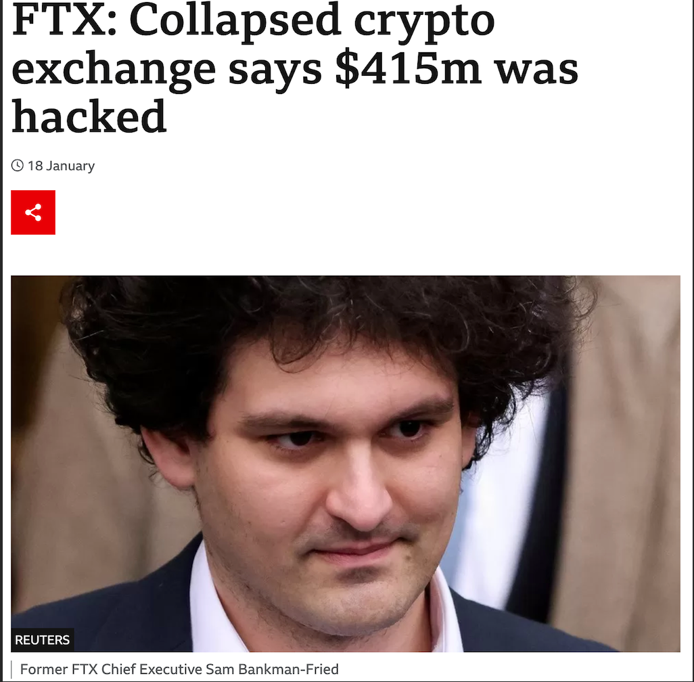
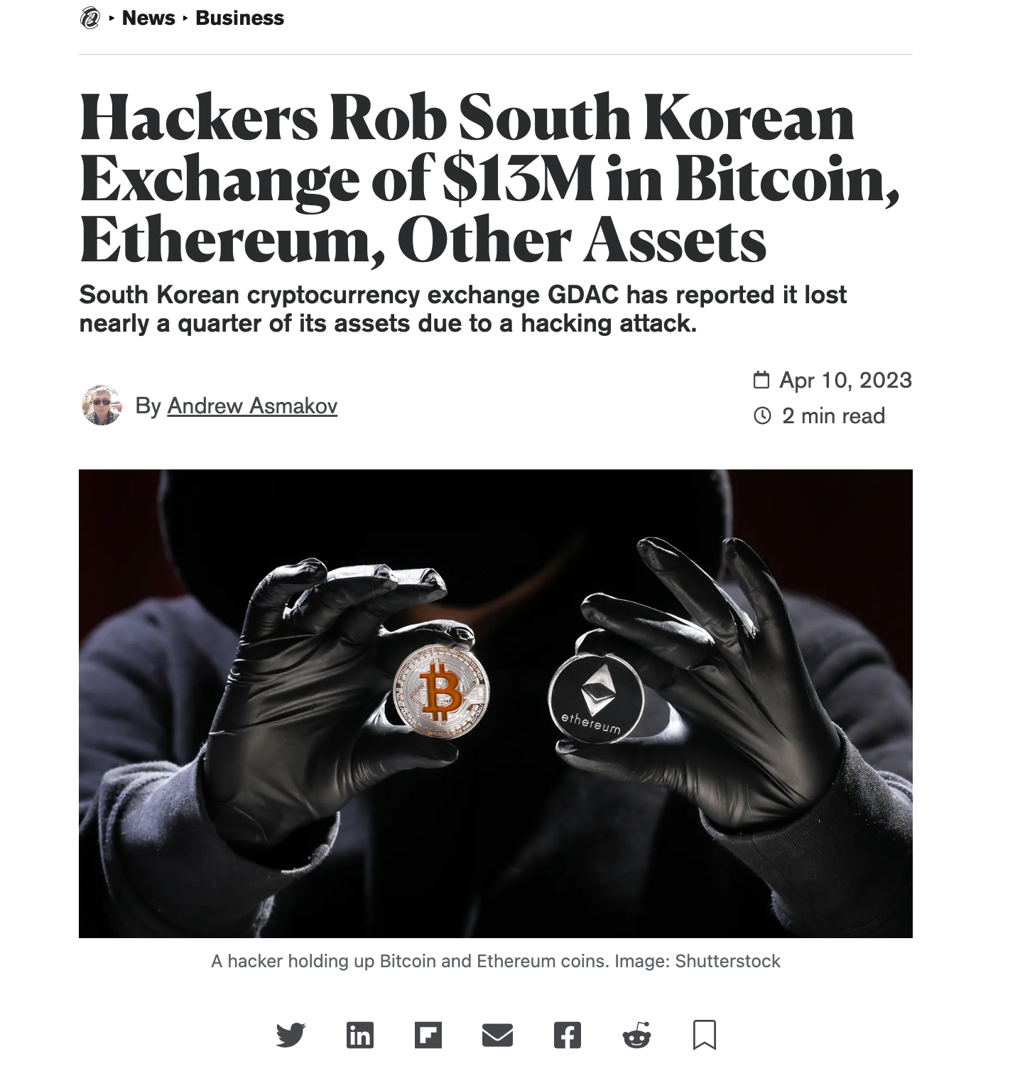
해커가 훔친 디지털 통화
배경
Notes:
ㅗㅁㄴ로해ㅑㅂ도헤ㅗㅠㅔㅈ규ㅗ

Slide 5
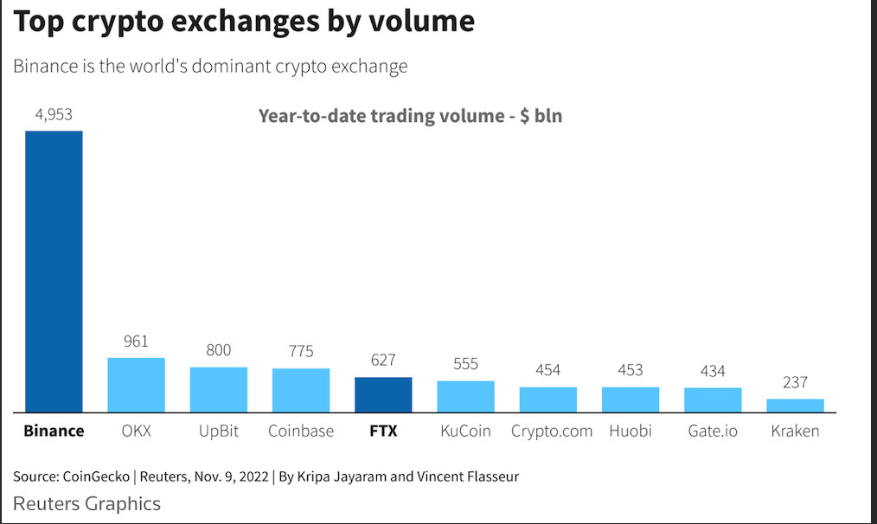
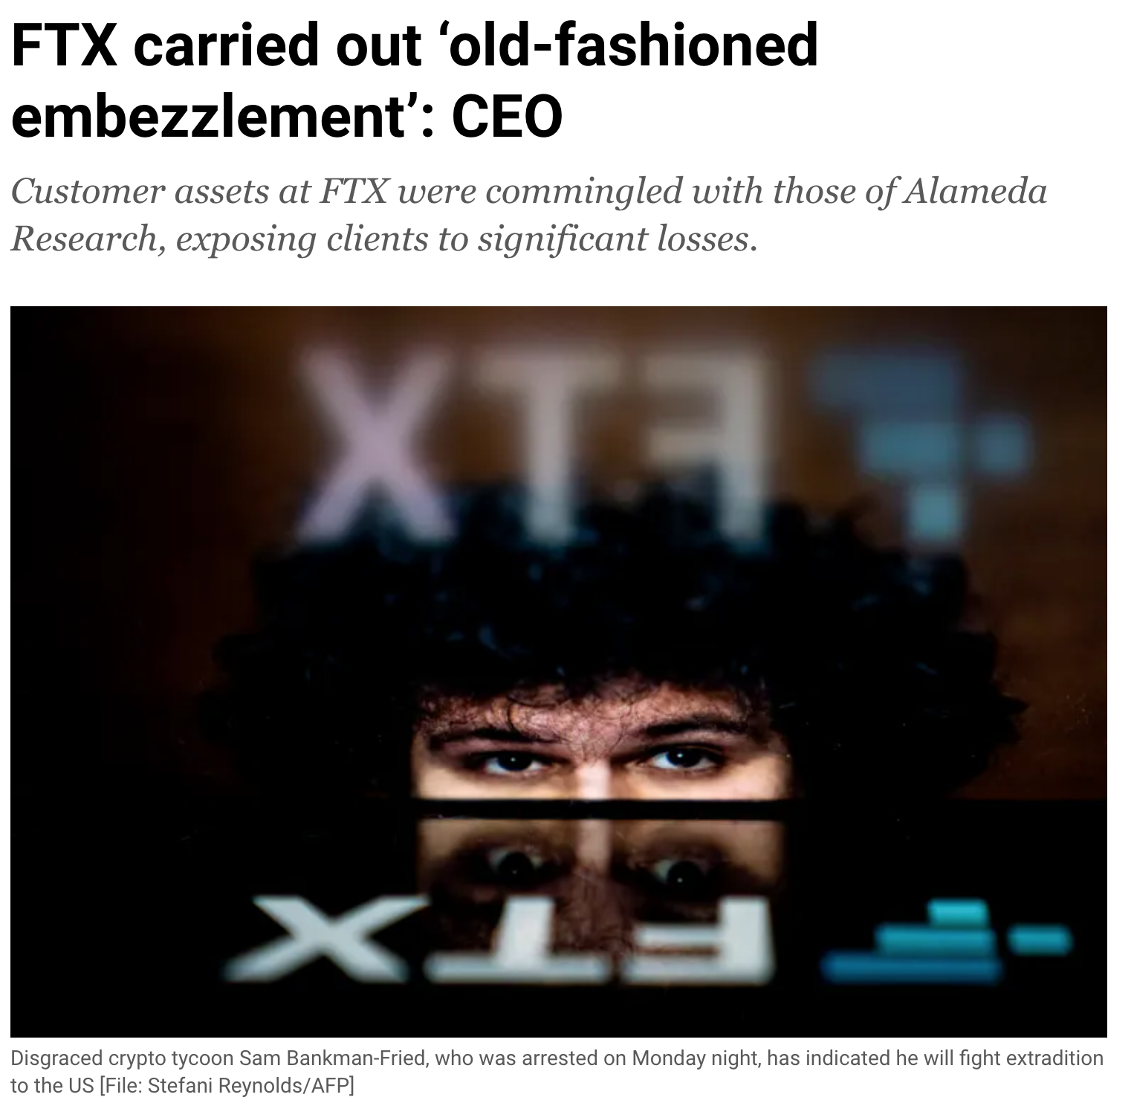
막대한 손실을 초래하는 고객 자산의 유용
배경
Notes:
ㅗㅁㄴ로해ㅑㅂ도헤ㅗㅠㅔㅈ규ㅗ

Slide 6
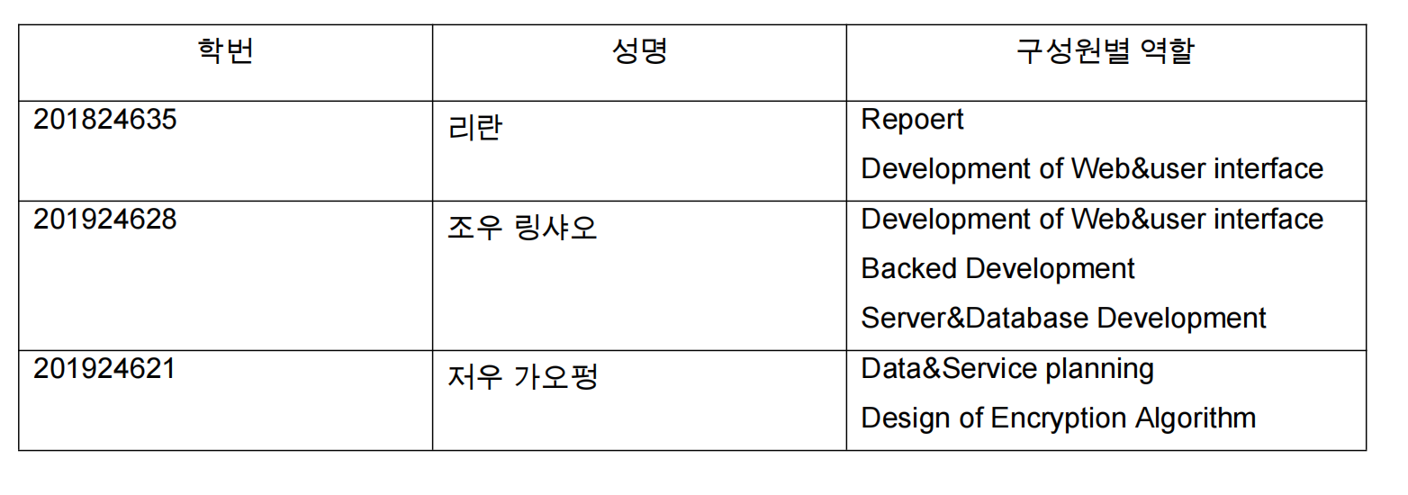
구성원별 역할
Notes:
ㅗㅁㄴ로해ㅑㅂ도헤ㅗㅠㅔㅈ규ㅗ

Slide 7
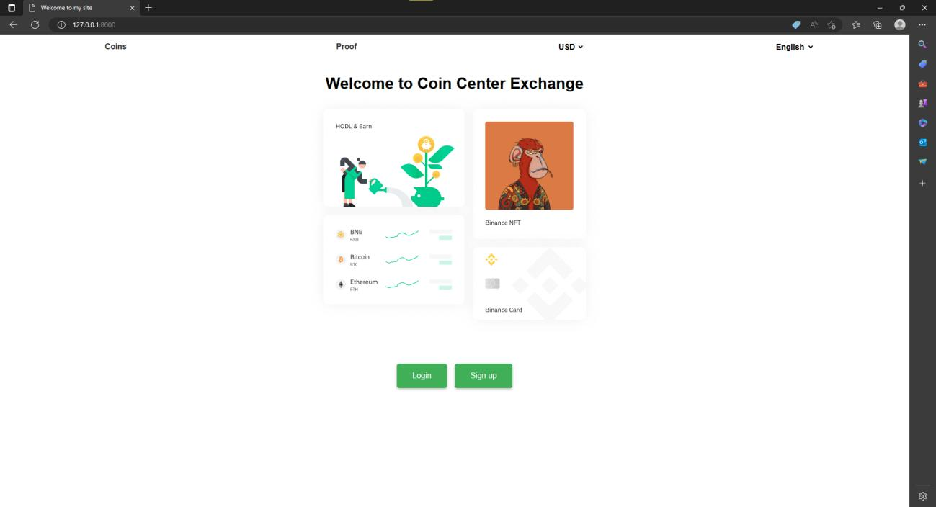
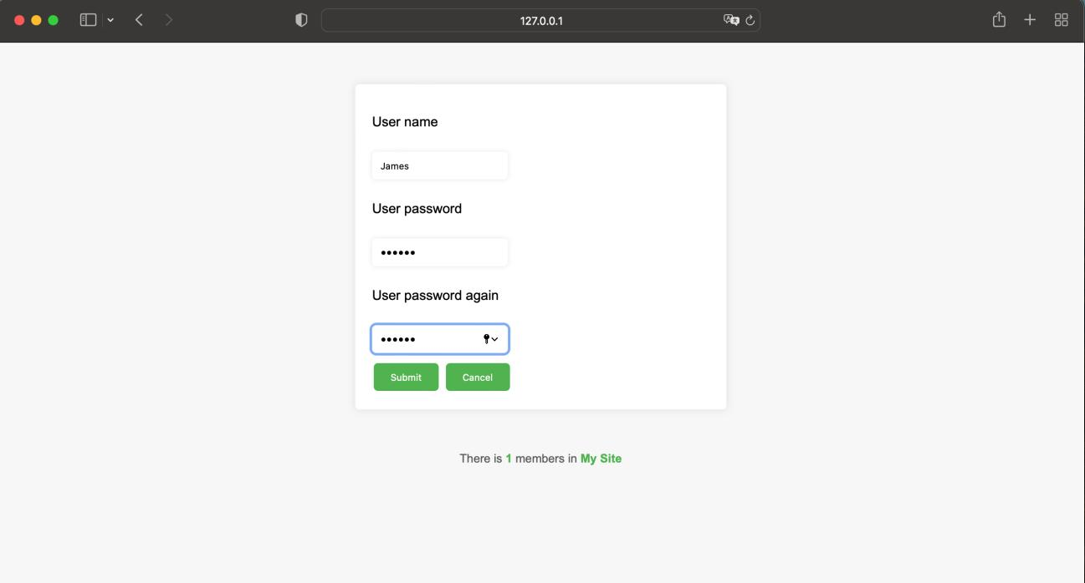
구현 내용
index page
login page
Notes:
ㅗㅁㄴ로해ㅑㅂ도헤ㅗㅠㅔㅈ규ㅗ

Slide 8
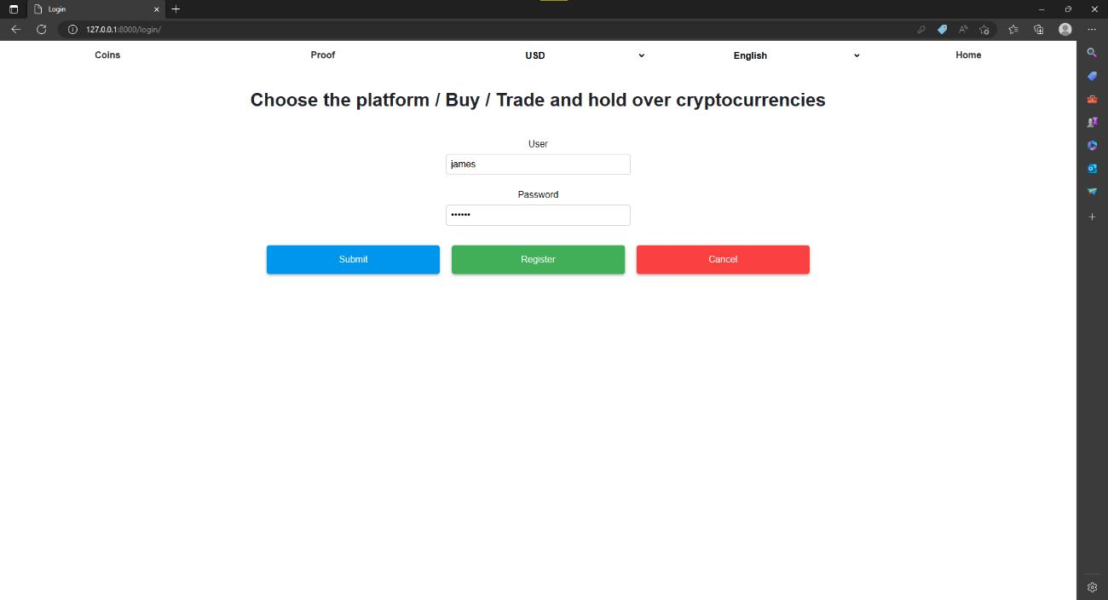
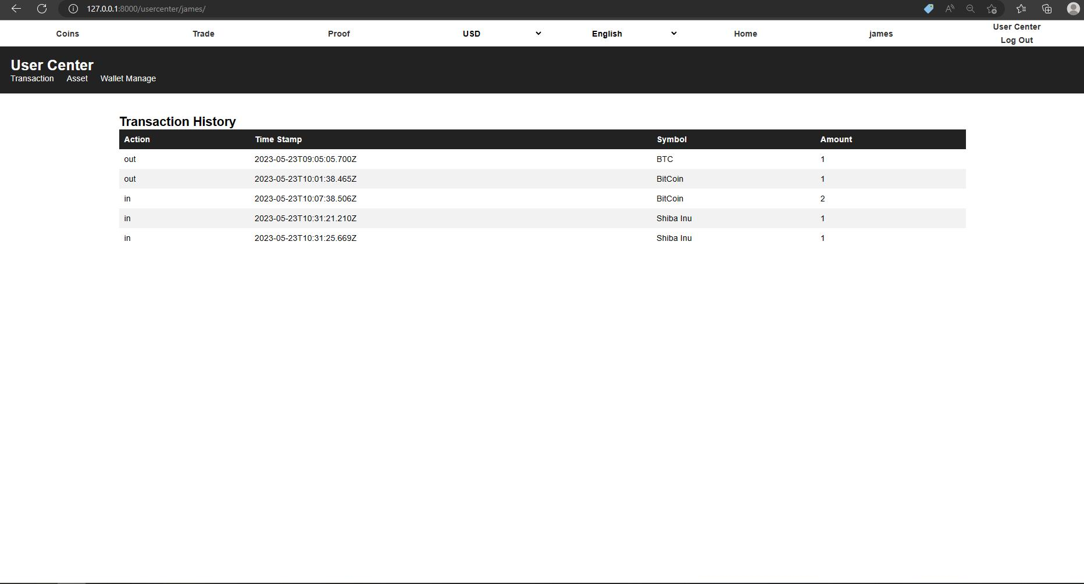
구현 내용
login page
user center page

Slide 9
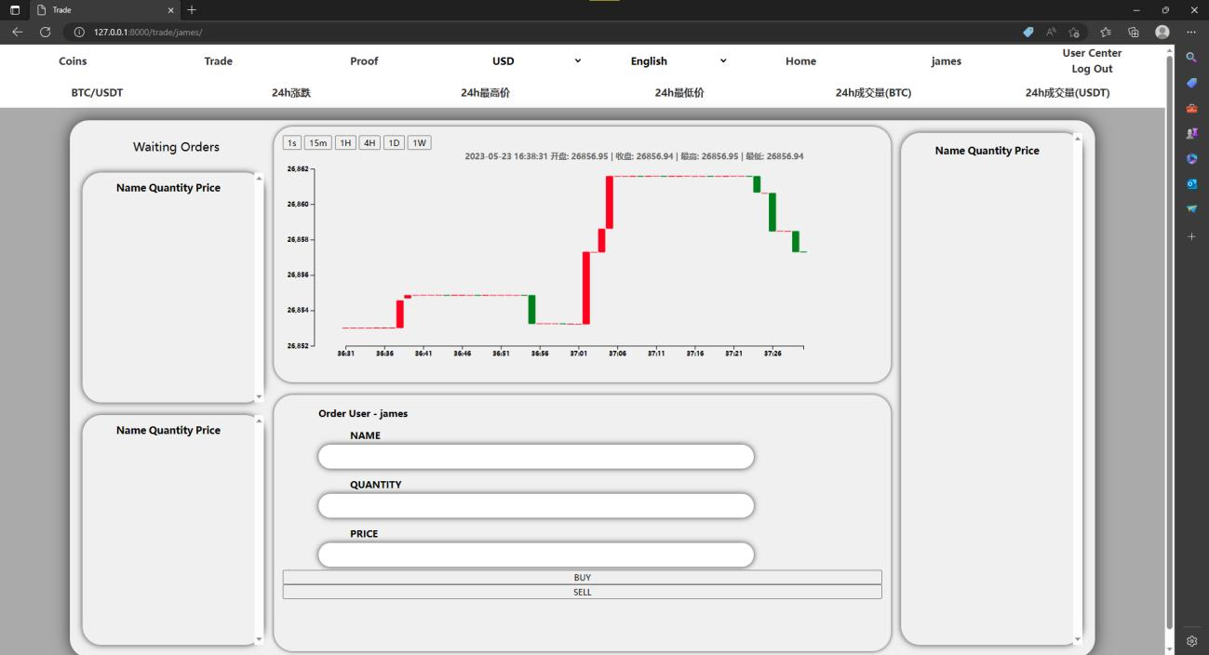
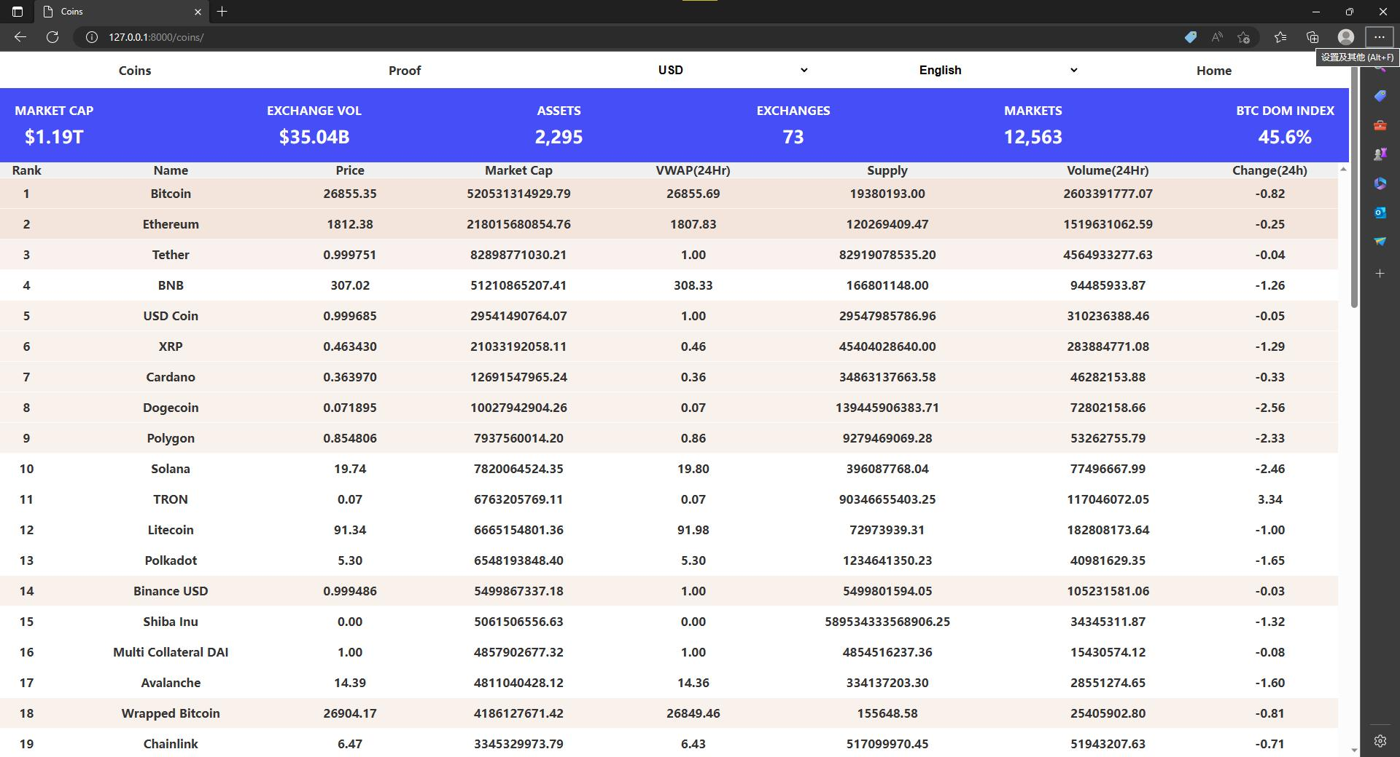
구현 내용
real time trade system
실시간 거래 시스템
coins price showing
실시간 코인 가격

Slide 10
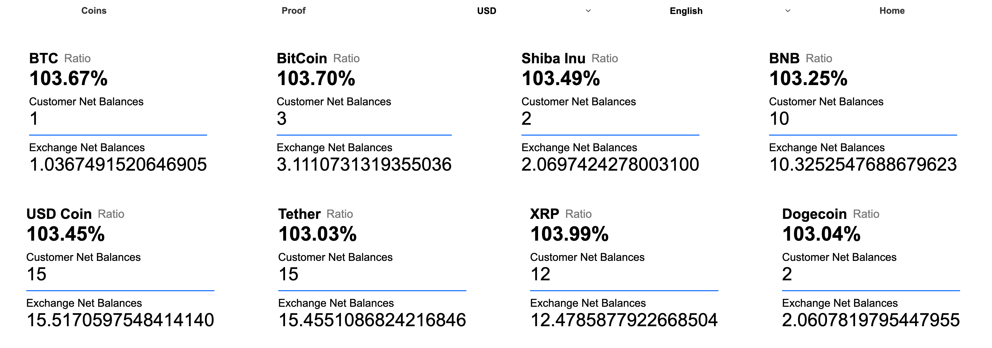
proof
구현 내용
exchange proof of resources
거래소 자산인증서

Slide 11
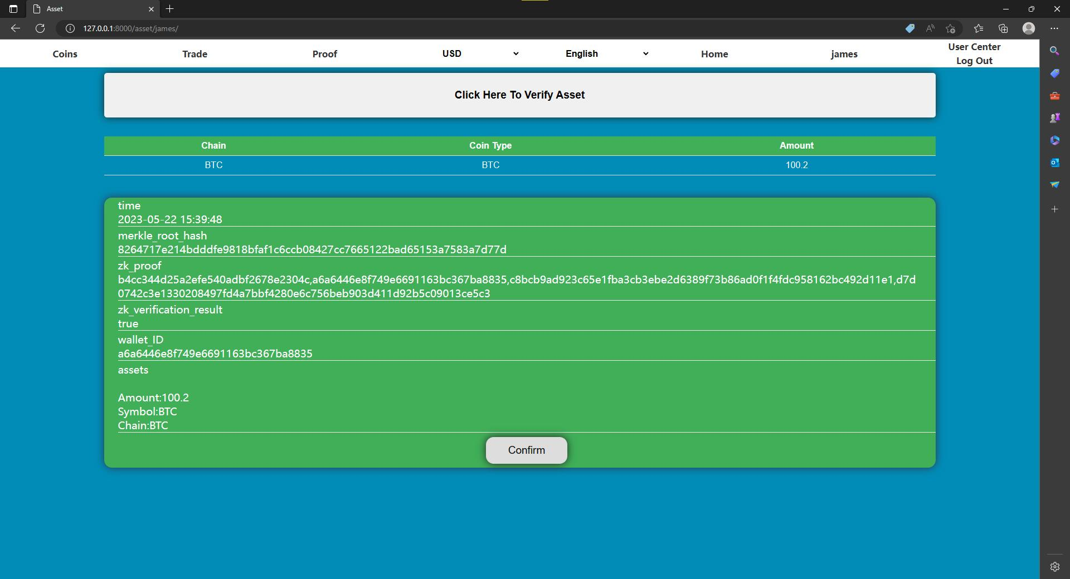
구현 내용
user asset verification
고객 자산인증서

Slide 12
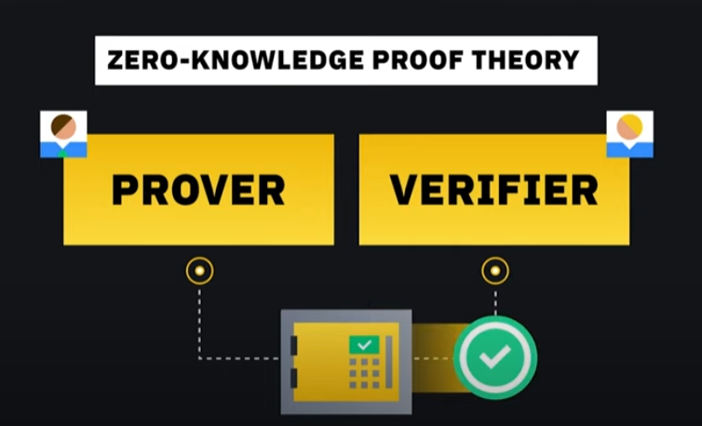
구현 내용
Notes:
123

Slide 13
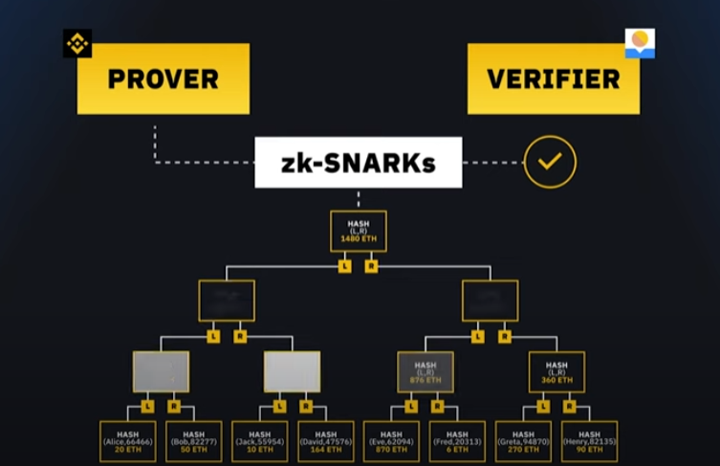
구현 내용

Slide 14
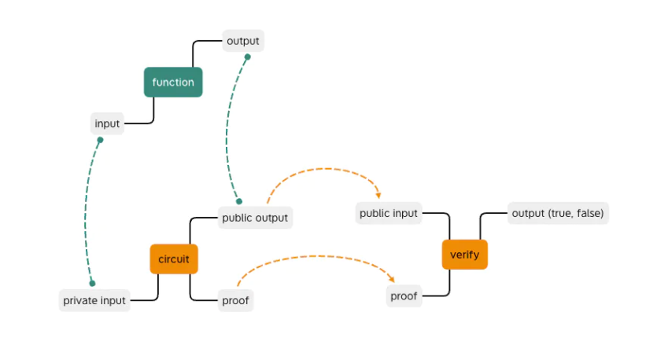
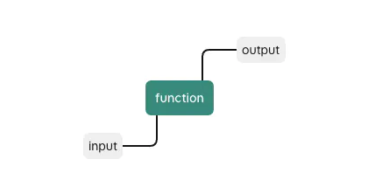
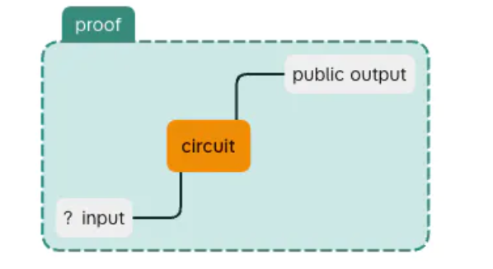
If this function is a hash algorithm, then any file can be input to get the corresponding hash value.
구현 내용
prove
if (계산하는 해시값 = 공개하는 해시값) =(입력 파일 = 찾고 있는 파일)
(prove만 제공하면 된다)
검사할 때 hash value & proof ---> verify =====>TRUE
prove
알 수 없는 input prove을 통해 ---> public output 생성

Slide 15
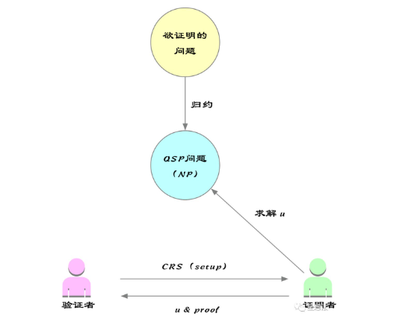
구현 내용
ZK_SNARKs(zero-knowledge succint non-interactive arguments of knowledge)
Zero-knowledge proofs allow one individual to prove to another that a statement is true, without disclosing any information beyond the validity of the statement.
Logical framework of zk_SNARK
To verify the issue
zk_SNARK consists of four parts
1:다항식 문제의 변환（quadratic equation of polynomials）
2：무작위 샘플링에 의한 간결함（Succinctness by random sampling）
3：동형 인코딩/암호화（Homomorphic encoding / encryption）
Reduction
QSP issue (NP)
Solve
4:제로 지식(zero knowledge)
Verifier
Prover

Slide 16
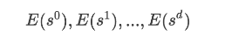
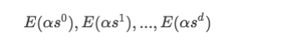
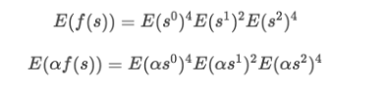
구현 내용
1:다항식 문제의 변환（quadratic equation of polynomials）
3.1 Fundamentals of finite group theory (elliptic curves):
By way of finite group encryption:E(x):=g^{x} (When g^{x} is known, x cannot be inferred)
3.2 Select random number:
The verifier randomly selects elements in a finite group, such as s
3.3 E(f(s)) Calculation:E(f(s)) can be calculated from the data provided by the verifier without knowing S
3.4 Alpha(α) pairs:Indicates that the verifier can confirm that the certifier calculates the result through a polynomial
The prover needs to provide E(f(s)) and E(af(s)):

Slide 17
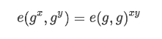
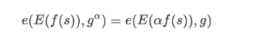
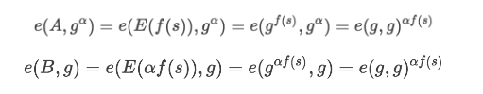
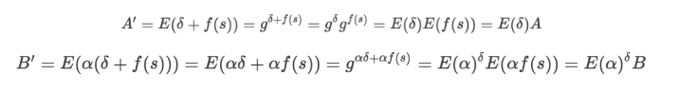
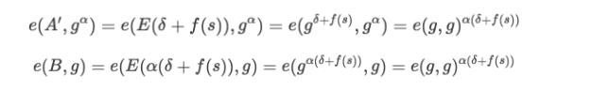
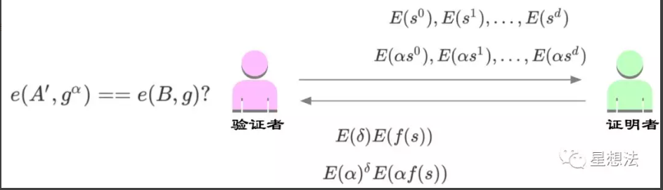
구현 내용
3.5 pairing function e:
The verifier verifies the a pairing and checks whether the following equation holds:
Suppose A=e(E(f(s)), B=E(af(s)):
3.6 Delta(δ) shift:The prover uses δ offset & does not provide A and B, but provides A'and B' with a random A parameter
Obviously, the verifier cannot derive E(f(s)) from A’, but the verifier can also verify whether the pairing function of αpairs is established:
Prover: Put the QAO/QSP polynomial in the above problem on the elliptic curve discrete logarithm
Verifier: Perform binary operations on the generated elliptic curve discrete logarithm points to quickly verify the correctness of the vector s, but do not know the vector s
Verifier
Prover

Slide 18
구현 내용
2.무작위 샘플링에 의한 간결함（Succinctness by random sampling）
Randomly select the value s for verification, and verify t(s)h(s) = w(s)v(s)
.
Compared with verifying that the polynomials are equal t(x)h(x) = w(x)v(x),
the verification is randomly selected, which is simple and requires less verification data.

Slide 19
구현 내용
3.동형 인코딩/암호화（Homomorphic encoding / encryption）
(anti-counterfeiting)
Homomorphic hiding means that the calculation of the input and the calculation of the output remain "homomorphic"
Definition of homomorphic hiding: E(x) is a function of x that satisfies:
(Example; additive homomorphism)
1.It is difficult to deduce x from E(x)
2. Different x will get different E(x) values
3.If E(x) and E(y) are known, then E(x+y) can be calculated.

Slide 20
구현 내용
4.제로 지식(zero knowledge)
The prover and the verifier have no knowledge other than the "proof of the statement" knowledge.
They do not know any other information, (such as the randomly chosen values or the polynomial calculation results of the chosen values. etc.）

Slide 21
구현 내용
Logical framework of zero-knowledge proof
zk-SNARK proof consists of the following steps:
1. Problem Transformation: A NP problem that needs to be proved is transformed into a selected NP problem (such as the QSP problem)
2. set up：The process of setting parameters is also the process of picking random numbers and providing CRS
3. The prover obtains the proof u and calculates the proof through CRS
4. The verifier verifies the proof and the proof of the response
To verify the issue
Reduction
QSP issue (NP)
Solve u
Verifier
Prover
NP :Nondeterministic Polynomial time
QSP:Quadratic Arithmetic Programs (Verify calculation results)
CRS:Common Reference String

Slide 22
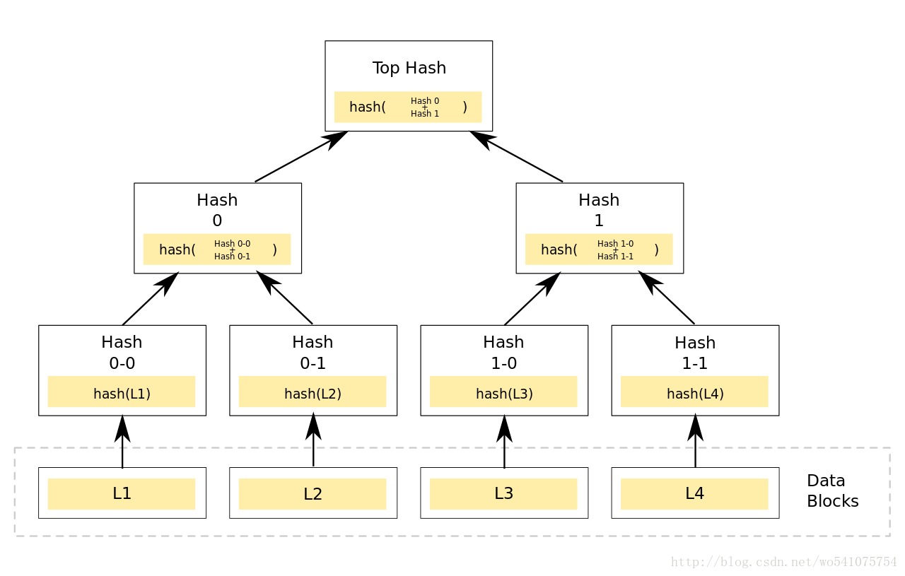
구현 내용
How to create a Merkle Tree？
Step1: Perform hash operation on the data block, Hash=Hash(L1), Hash=Hash(L1)
step2: Do hash operation on Hash 0-0 and Hash 0-1, Hash 0=Hash(L1)+Hash(L2)
step3: Do hash operation on Hash 0 and Hash 1, Top Hash = Hash (0) + Hash (1)

Slide 23
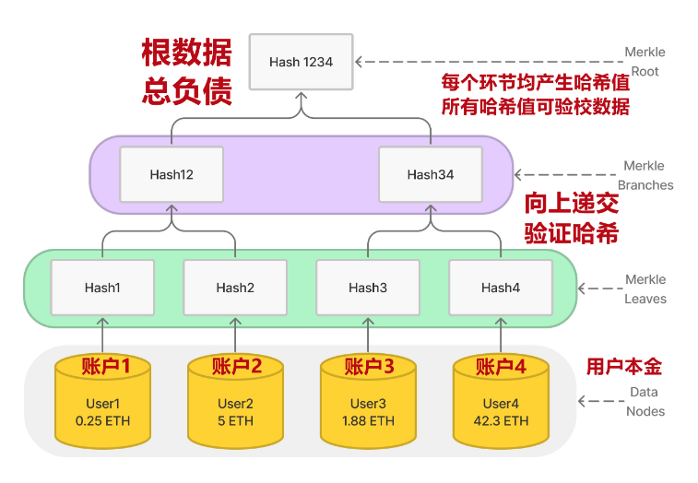
구현 내용
Root Data Total Liabilities
Merkle Root
Each link generates a hash value. All hash values ​​can be verified.
Submit verification hash
up
accoun1
accoun2
accoun3
accoun4
user assets
Why can CEX using Merkle Tree prove that the total liability data is authentic?
For each user's balance (leaf nodes of the Merkle tree), we will ensure:
1:Each user's asset balance is included in the sum of the user's net balance on the exchange.
2:The user's total net balance is greater than or equal to zero.
3、Changes to the root of the Merkle tree are valid (i.e. information cannot be falsified) after the user information has been updated to the leaf node hash.
Merkle proof is to connect the sub-hash and calculate the hash value recursively until the root hash value is obtained as the public key.

Slide 24
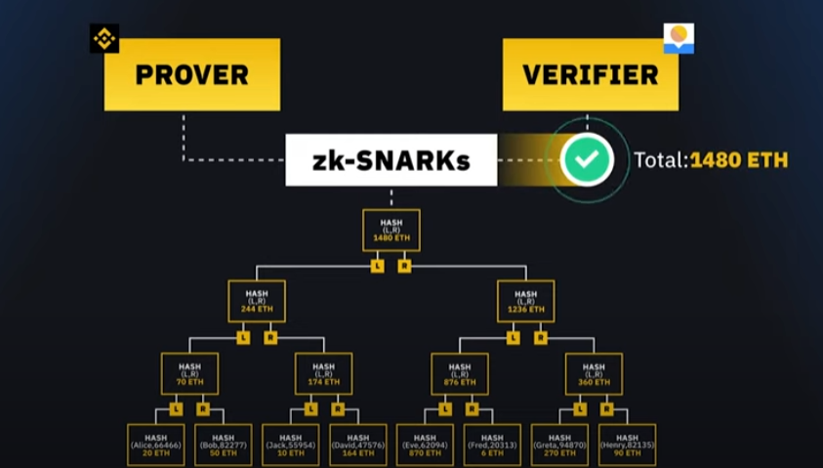
구현 내용

Slide 25
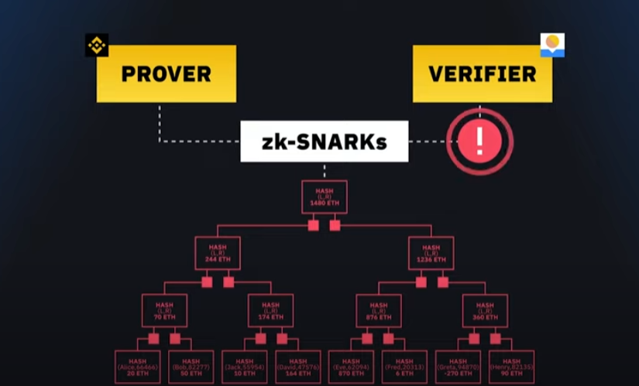
구현 내용
A new innovative,accurate,verifiable,secure way to show the total amount of user-assets held by exchange
without revealing private information

Slide 26
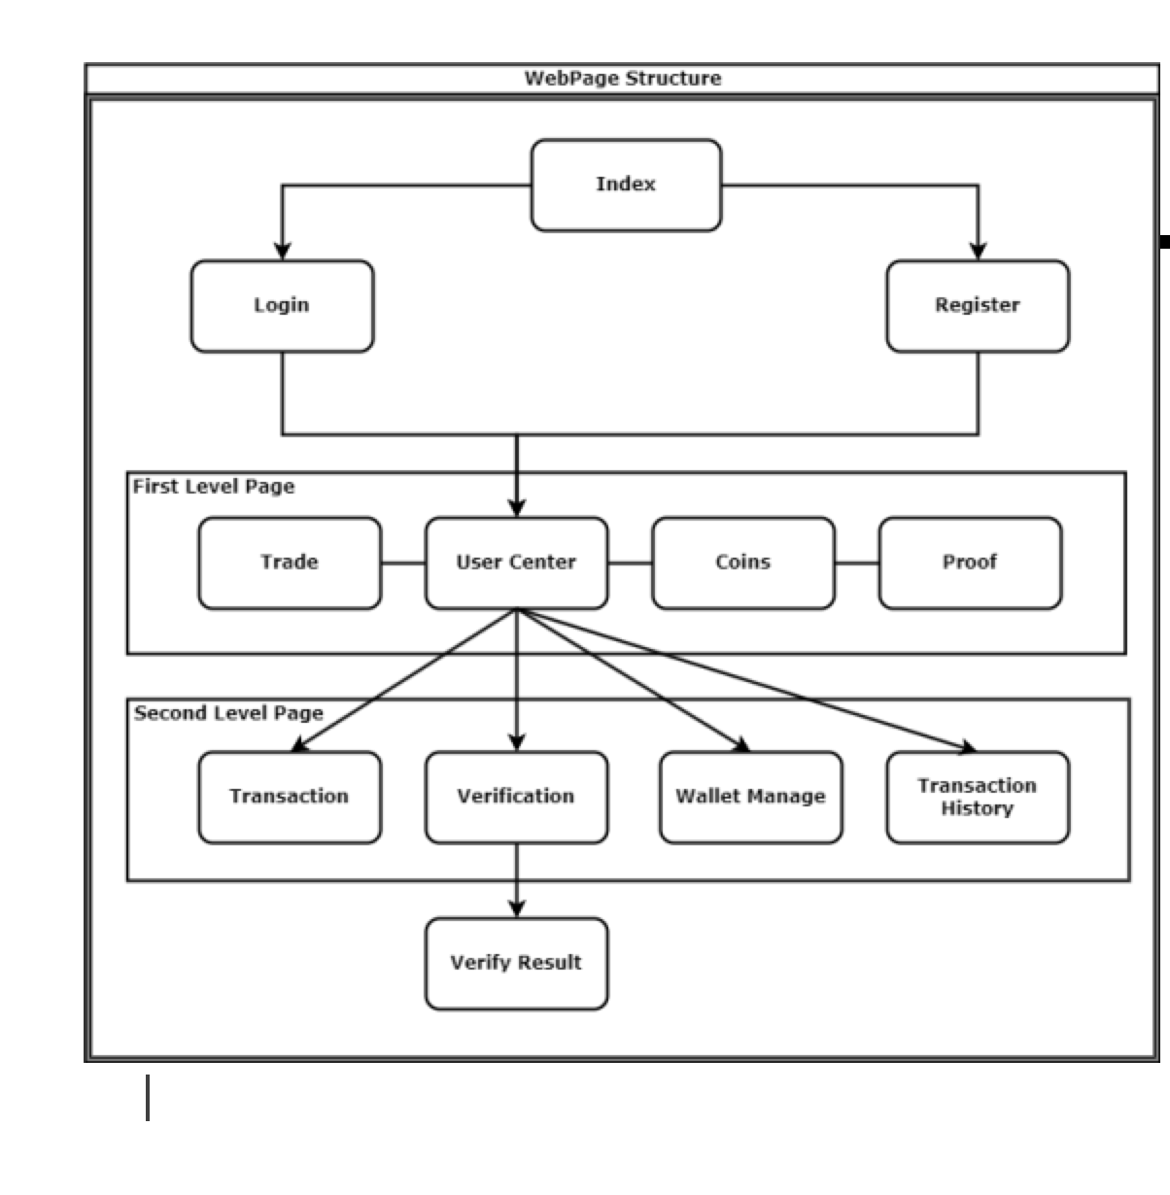
구현 내용
Web structure

Slide 27
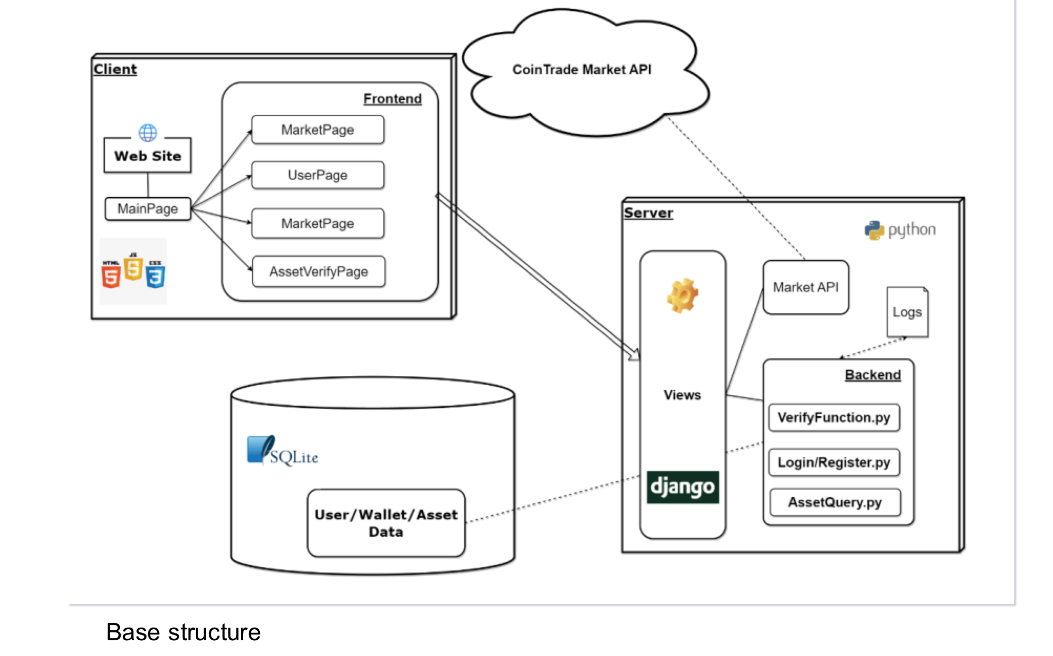
구현 내용

Slide 28

결론

